Slide 1
SMART LOAN APPROVAL AND PREDICTION SYSTEM
MINI PROJECT(Web Based Application)
Developed by
K MARISHA RAGAVI
24082100801412015
II MCA
Guided by
Mrs.P.SHEELA JASMINE M.Sc.,B.Ed.,NET.
Assistant Professor,

Slide 2
ABSTRACT
The Smart Loan Approval Prediction System is a web-based application developed using PHP and MySQL to simplify and automate the loan approval process in financial institutions. Traditional loan approval methods require manual verification of applicant details such as income, employment status, credit score, and repayment capacity. This manual process often leads to delays, errors, and inconsistency in decision-making. The proposed system addresses these challenges by providing an automated and intelligent platform that predicts an applicant’s eligibility for loan approval based on predefined rules and stored data. It integrates predictive algorithms that analyze user data efficiently and determine whether a loan should be approved or rejected. The system provides faster decision-making, improved accuracy, and better transparency compared to traditional methods. It also minimizes human intervention, reduces workload for bank staff, and eliminates possible biases in approval decisions.With its user-friendly interface, applicants can easily apply for loans and instantly know their eligibility status. This not only saves time for both applicants and banks but also enhances the overall user experience.
Overall, the Smart Loan Approval Prediction System promotes automation, accuracy, and reliability in financial services by combining technology, data analytics, and intelligent prediction techniques.

Slide 3
OBJECTIVES
To automate and simplify the loan approval process
To reduce manual work and human errors
To predict loan eligibility using predefined rules
To provide a user-friendly and secure web portal
To allow online loan applications and document upload
To give real-time loan status updates to users
To help admins verify and approve applications easily
To ensure transparency and accuracy in decisions
To analyze data for better loan management

Slide 4
Existing system
Loan process is manual.
Applicants submit physical documents.
Verification is time-consuming.
Paper records are hard to manage and insecure.
Human errors and bias affect decisions.
No real-time updates for applicants.
No automation or prediction tools.
Banks have more workload and costs.
Process is inefficient and not transparent.

Slide 5
PROPOSED SYSTEM
Automated and intelligent system replacing manual loan approval process.
Uses data analysis, machine learning, and rule-based verification for accuracy.
Allows users to create accounts, log in, and submit loan applications online.
Supports uploading of digital documents like ID proof, income proof, and photos.
Automatically validates user details and securely stores data in the database.
Predicts loan approval using algorithms that calculate approval scores.
Provides real-time updates and tracking for applicants to view application status.
Admin dashboard helps staff review applications efficiently and reduce workload.
Ensures faster, fairer, and paperless loan processing with improved accuracy and security.

Slide 6
HARDWARE CONFIGURATION
Processor (CPU): Intel Core i3 or above / AMD Ryzen 3 or above – to handle application logic and database operations efficiently.
RAM: Minimum 4 GB (8 GB recommended) – for smooth running of web server, PHP, and database.
Storage: Minimum 100 GB HDD or 50 GB SSD – to store the system, database, and uploaded documents.
Display: 14-inch or larger monitor – for clear viewing of forms, dashboards, and admin panels.
Network: Stable internet connection – for accessing web-based interfaces and sending email notifications (simulated or real). Peripherals: Keyboard, mouse, and optional printer – for input and printing loan documents if required.

Slide 7
SOFTWARE CONFIGURATION
Operating System: Windows
Web Server: XAMPP
Database: MySQL
Backend Language: PHP
Frontend: HTML, CSS, JavaScript
Chart Library: Chart.js (for admin dashboard)
Browser: Chrome/Edge

Slide 8
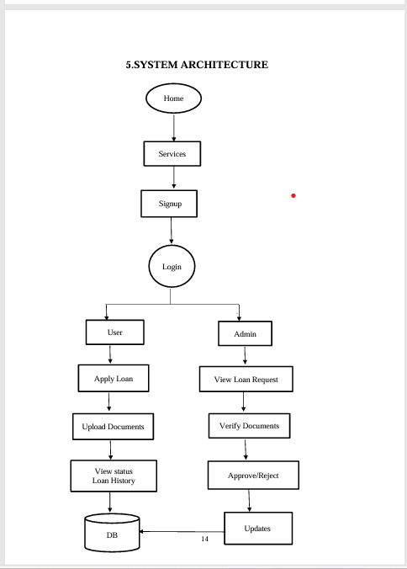
SYSTEM ARCHITECTURE

Slide 9
PROJECT DESCRIPTION
Allows users to apply for loans and predicts approval chances using predefined rules.
Smart Loan Approval Prediction System A web-based application that automates and simplifies the loan approval process.
Administrators can verify documents, manage applications, and view dashboards.
Front-End Tools:
HTML
Used to create the structure of web pages.
Designs forms (loan form, document upload), tables (loan history), and navigation links.
Example tags: <form>, <input>, <table>.

Slide 10
CSS
Used to style and design the web pages.
Changes background colors and aligns form fields neatly.
Adds colors for buttons, headings, and tables to improve readability.
Back-End Tools :
PHP Server-side scripting language for processing and logic.
Handles: Receiving user inputs.
Calculating loan approval using rules.
Updating loan status in the database. Managing sessions for user/admin.

Slide 11
Server:
Server Details : XAMPP (Apache, MySQL, PHP, Perl) Provides a local server environment for testing.
Runs: Apache Server – Displays web pages. MySQL Server – Stores and manages database.
Easy to install and test before deployment.
Database:
Database Used: MySQL Relational Database Management System (RDBMS).
Stores data in tables with rows and columns. Supports SQL queries to add, update, or retrieve data.
Stores user details, loan requests, and documents securely.

Slide 12
FUTURE ENHANCEMENT
Integrate Machine Learning for more accurate loan predictions.
Develop a mobile app for easy loan applications and tracking.
Automated credit scoring for objective decisions.
Banking API integration to verify accounts and transactions automatically.
Enhanced security with two-factor authentication and data encryption.
Interactive dashboards for admins to monitor trends and generate reports.
Support multiple loan types with tailored eligibility criteria.
Automated notifications via SMS, email, or app alerts.
AI chatbots for user assistance and policy recommendations.

Slide 13
CONCLUSION
The Smart Loan Approval Prediction System using PHP automates and streamlines the loan approval process, reducing manual work and human errors. Applicants can submit their details online securely, and the system provides a preliminary decision—approval, rejection, or pending—based on predictive rules. This ensures faster, consistent, and unbiased decisions while allowing users to track their application status conveniently. Built with PHP and MySQL, the system stores data securely and enables admins to manage multiple applications efficiently.

Slide 14
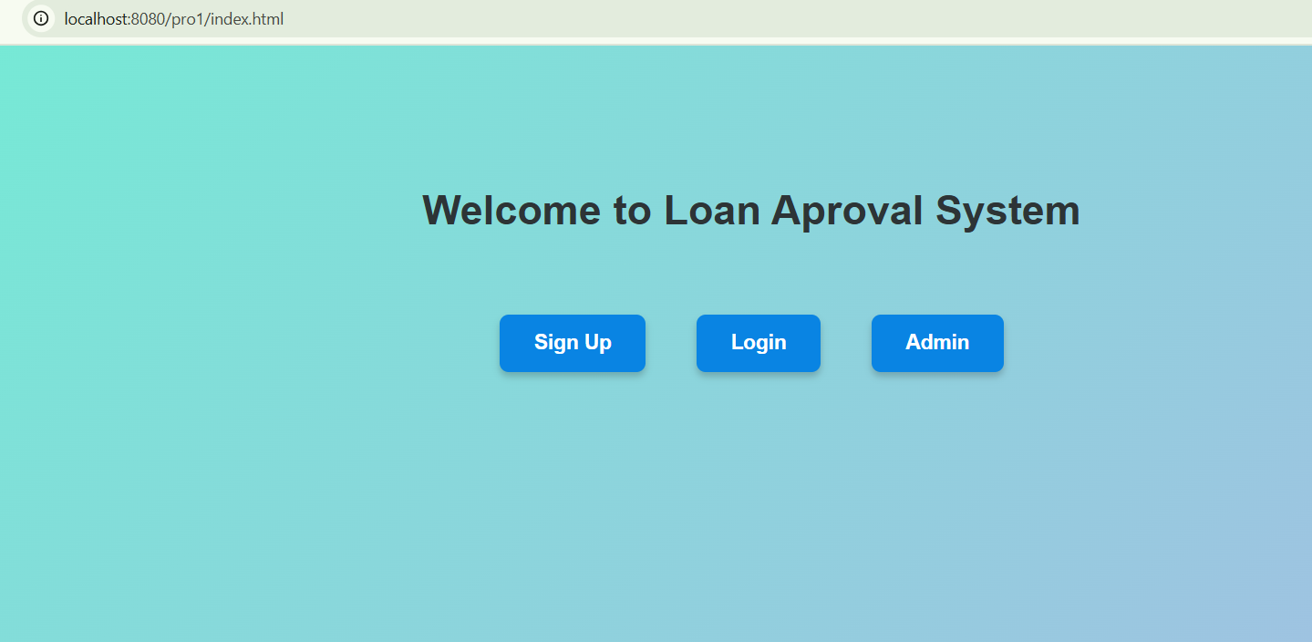
STEPS TO RUN THE PROJECT

Slide 15
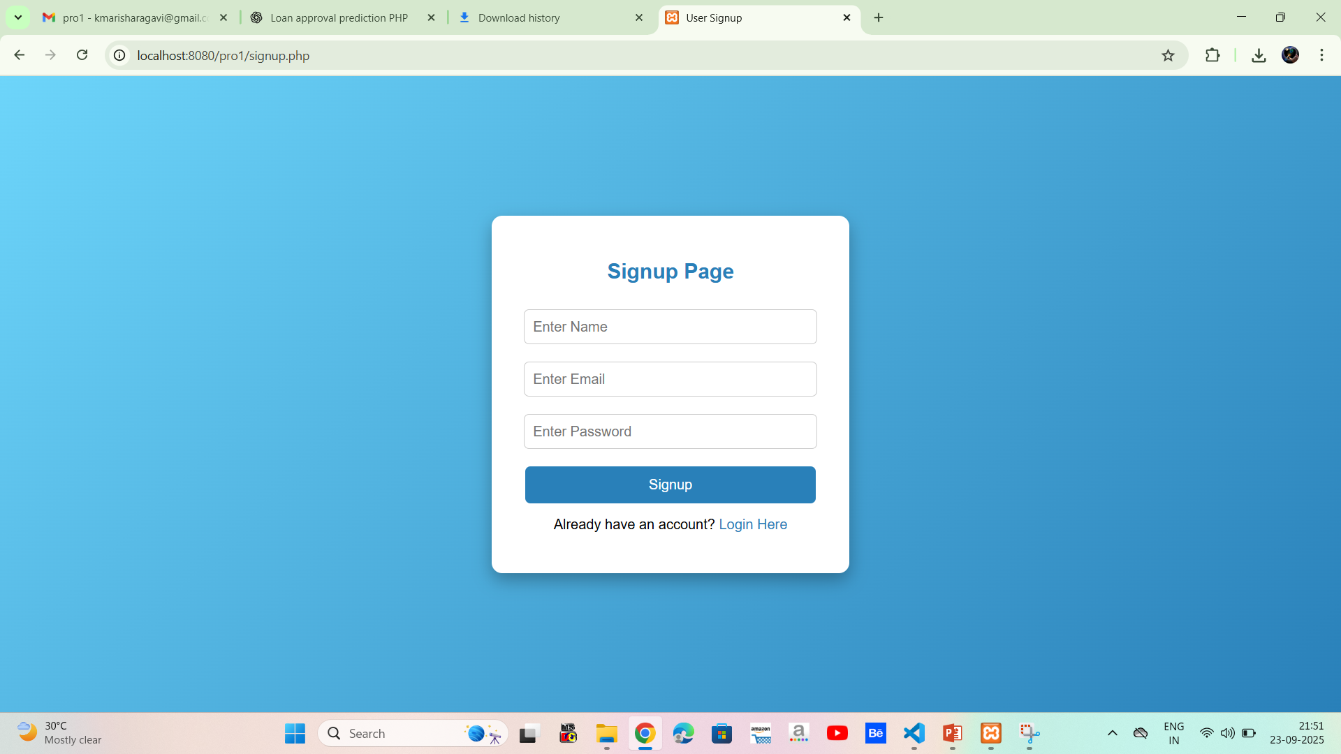
SIGNUP PAGE

Slide 16
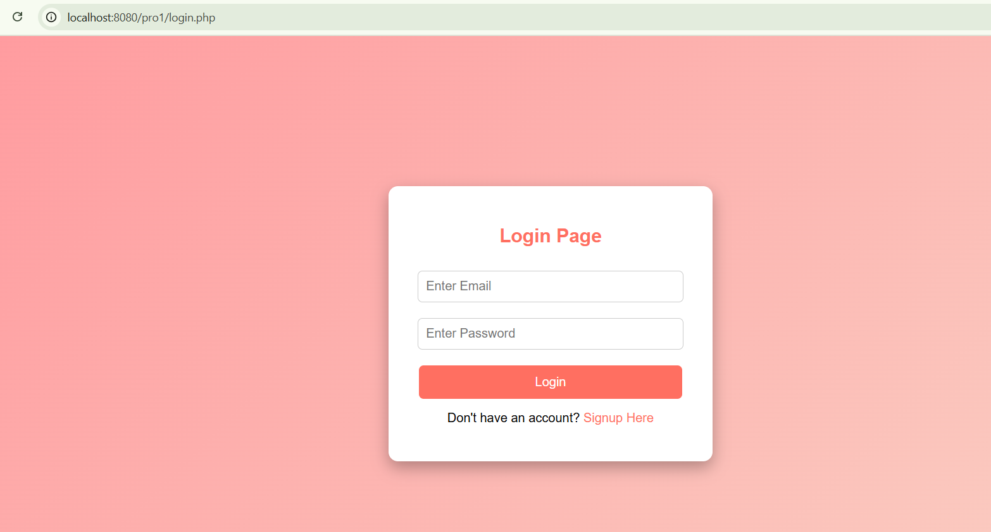
LOGIN PAGE

Slide 17
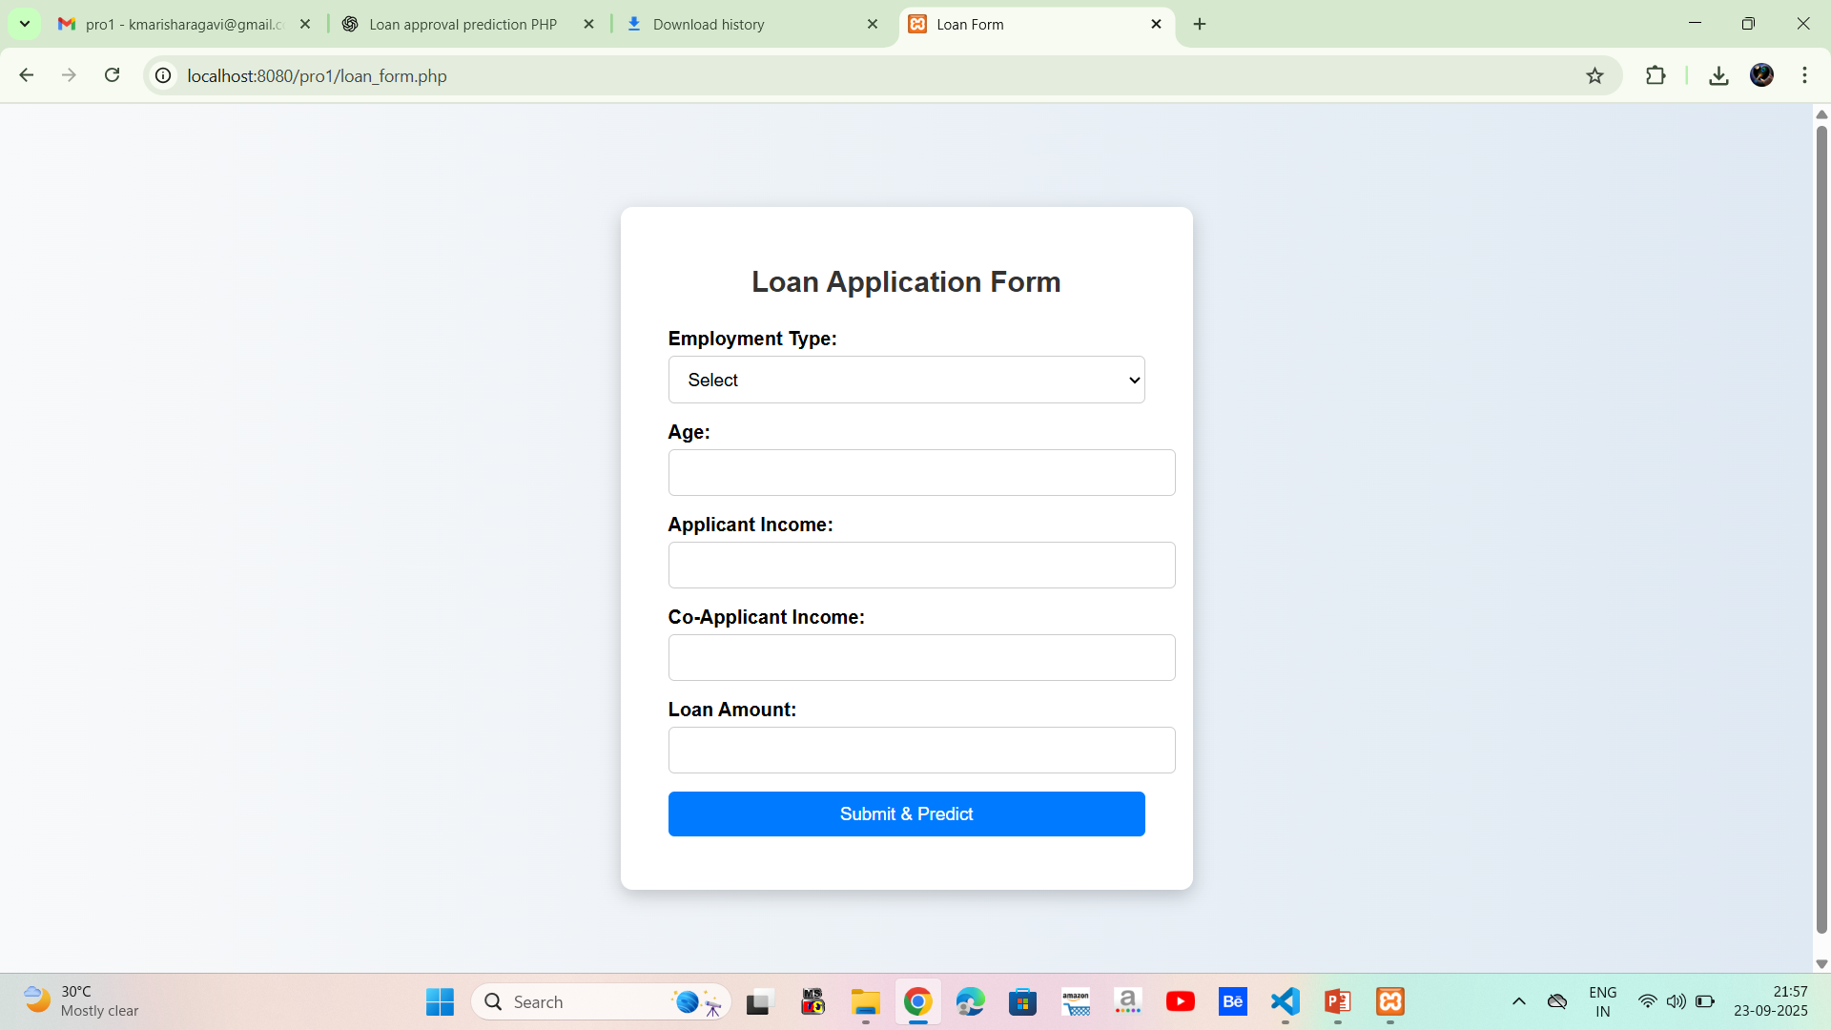
FORM PAGE

Slide 18
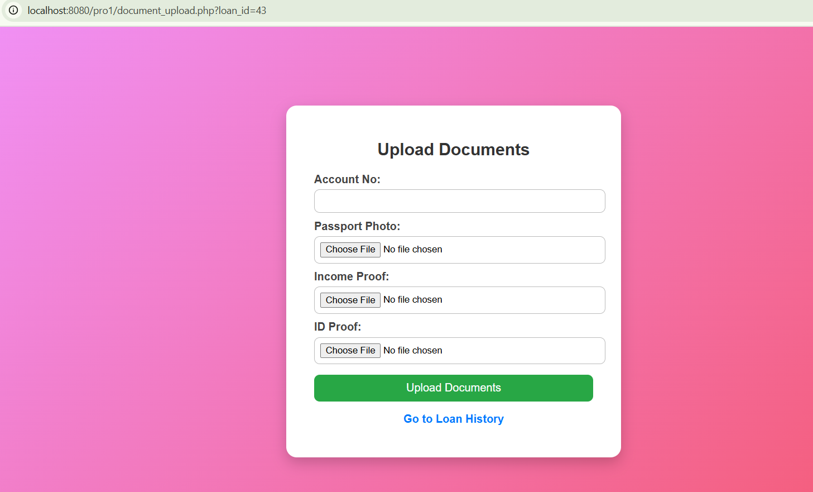
Document upload PAGE

Slide 19
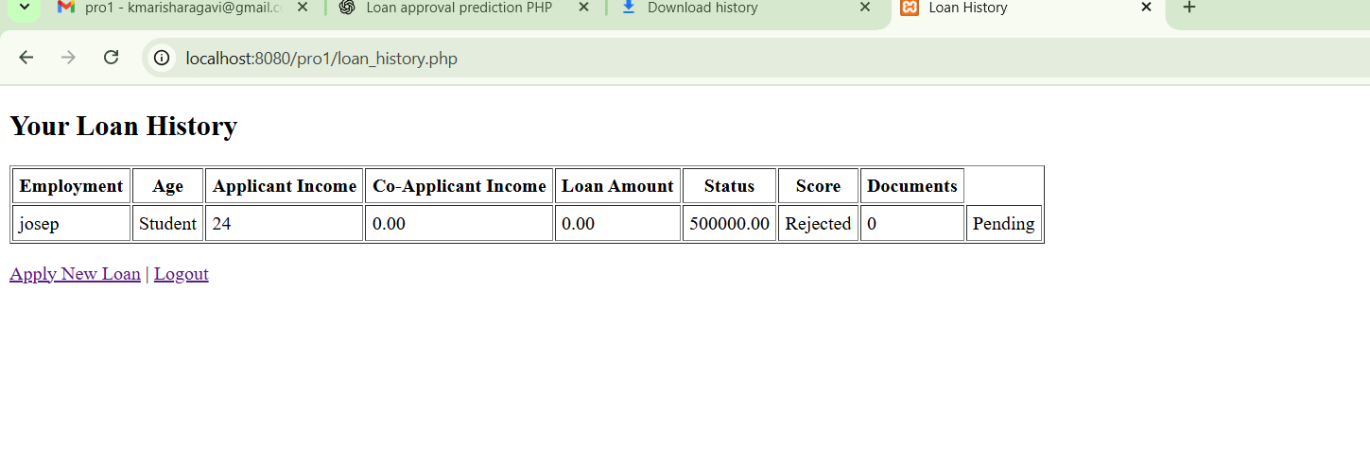
LOAN HISTORY PAGE

Slide 20
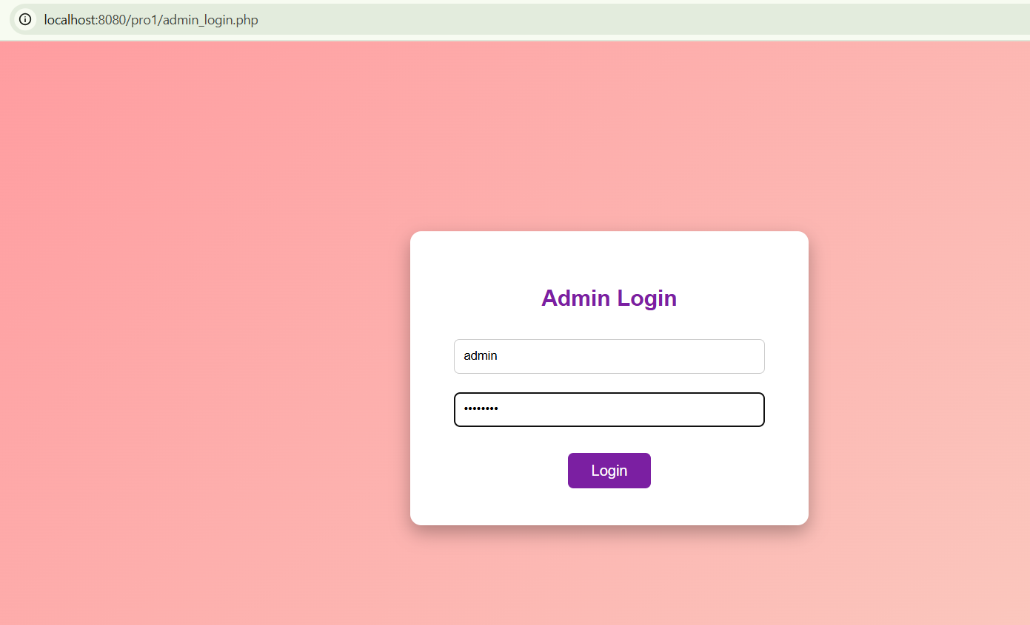
ADMIN LOGIN PAGE

Slide 21
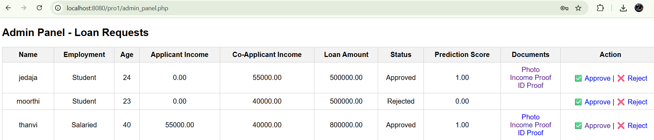
ADMIN PANNEL PAGE

Slide 22
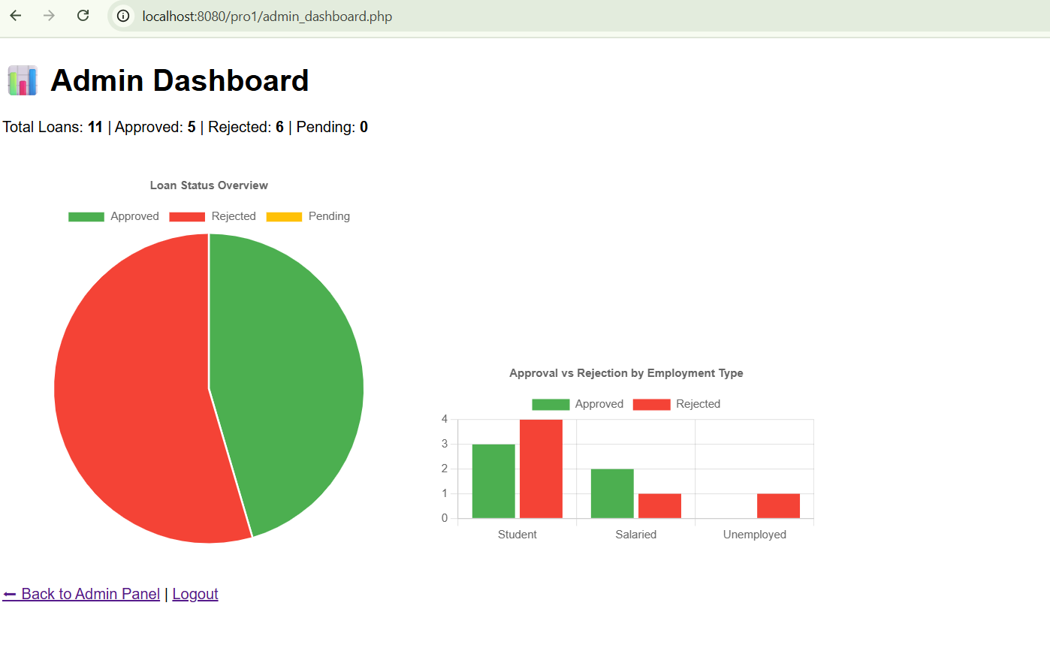
ADMIN DASHBOARD

Slide 23


